Slide 1
AGRO MART – A Direct Farmer to Consumer E-COMMERCE PLATFORM

Slide 2
Mini Project – Phase-1 Review
Domain: Agriculture + E-Commerce
Team Members:
Sneha
Kavya
Sai Venkat
Hari Narayana
Shanmuka
Guide: MR . MAHESH BABU
Guide:

Slide 3
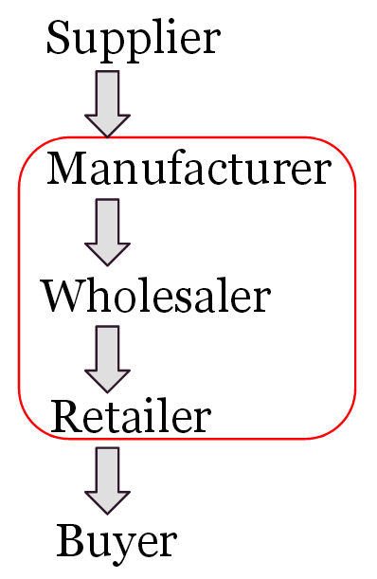
Abstract: Farmers can list crops with price and quantity. Customers can browse and purchase directly. Eliminates middlemen and ensures fair pricing. Benefits both farmers and end consumers. Supports transparency, freshness, and local farming.

Slide 4

Problem Definition:
Existing Problems:
Multiple intermediaries reduce farmer income.
Price manipulation in traditional markets.
Lack of transparency for customers.
No direct communication between farmer and buyer.
Defined Problem:
To design a system that enables direct agricultural product sales between farmers and customers using a digital platform.

Slide 5
Literature Survey – Summary
Existing e-commerce platforms focus on retailers, not farmers.
Government mandis still involve agents and commissions.
Some Agri -apps provide price info but not direct selling.
Studies show direct trade increases farmer income by 20–30%.

Slide 6
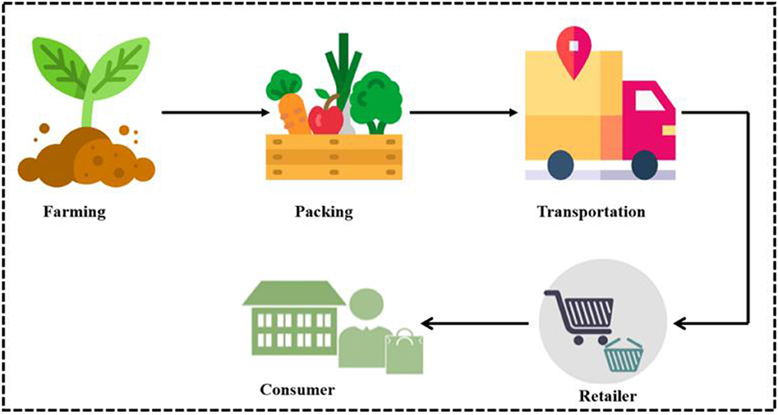
System Architecture
Main Components:
Farmer Module
Customer Module
Admin Module
Database Server
Flow: Farmer → Platform → Customer (No intermediaries)

Slide 7
Module-Wise Plan
1. Farmer Module
Registration & login
Add crop details
Update availability
2. Customer Module
View products
Place orders
Contact farmer
3. Admin Module
Manage users
Monitor listings
Handle issues

Slide 8
Tools & Technologies Required
Frontend: HTML, CSS, JavaScript
Backend: Python / Java / PHP
Database: MySQL
Platform: Web Browser
Tools: VS code , Git , Browser
Hardware Requirements:
Basic PC or Laptop
Internet connection

Slide 9
Future Scope
Agro Mart simplifies agricultural trade by enabling direct interaction between farmers and customers.
Mobile app version
Online payments
Delivery tracking
Farmer rating system

Slide 10
Thank youu

